Slide 1
FIT1047 Week 3 Forum
Introduction to Computer Systems, Networks and Security

Slide 2
Learning Outcomes
At the end of this workshop, you will be able to:
1. Understand the Von Neumann architecture and Moore’s Law
2. Learn about programs in general and machine code and assembly code in particular
3. Understand the fetch-decode-execute cycle in a CPU
4. Write simple assembly code programs using MARIE

Slide 3
Forum Activity
Activity 1: Discussion on computer architecture
Activity 2: Explanation of Marie architecture
Activity 3: Demo on simple programing using Marie

Slide 4
Activity 1: Von Neumann Architecture
Sketch the Von Neumann Architecture and explain what is the main function of the CPU.

Slide 5
Activity 1: Machine Code and Assembly Language
What are the differences between machine code and assembly language?

Slide 6
Activity 1: Memory Organization
Think of it as a sequence of “boxes”:
...
1004
3005
2006
7000
008E
0D80
0000
Each box contains a value (here: a 16-bit number).
This could be a machine code instruction, or data.
We give each box an address: the number of the box, starting from 0.
Programs can read and change the value stored at a location.
000
001
002
003
004
005
006

Slide 7
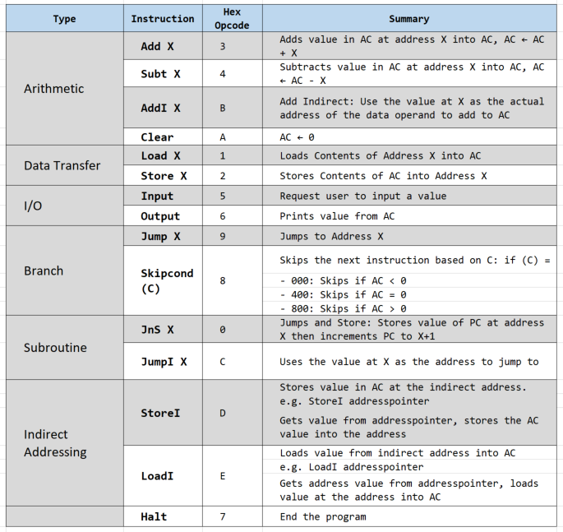
Activity 2: MARIE - Instructions
Briefly explain how MARIE instructions work.

Slide 8
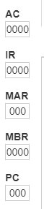
Activity 2: MARIE - Registers
In MARIE architecture, name all registers and state their functions. Why some registers only consist of 12 bits and others consist of 16 bits.

Slide 9
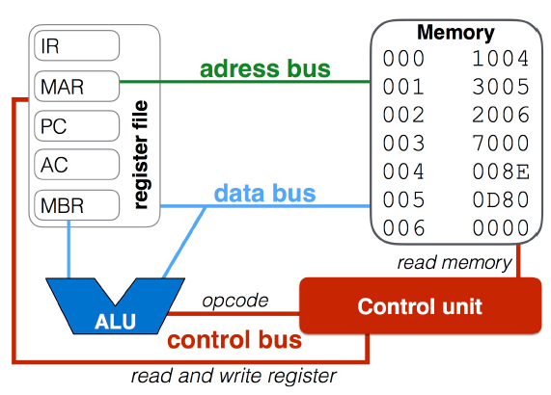
Activity 2: MARIE - RTL
What is RTL and what is the main function of control unit in CPU?

Slide 10
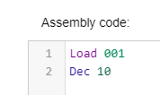
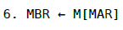
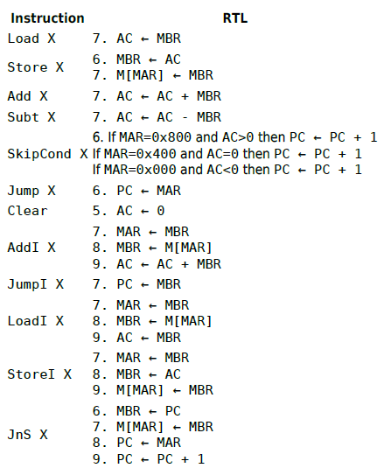
Activity 2: MARIE – RTL: Fetch-Decode-Execute
Analyze RTL fetch-decode-execute for Load X using the following MARIE code

Slide 11
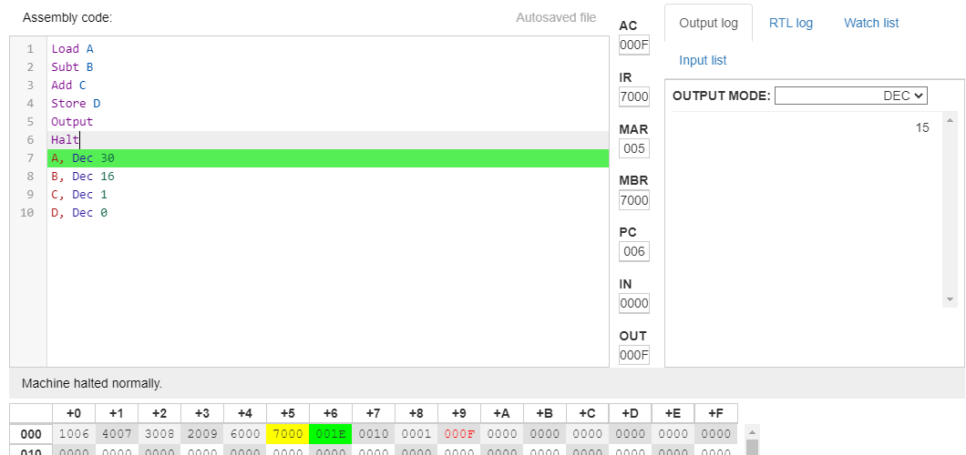
Activity 3: Marie Programming → Load, Store, Add, Subt, Halt
Using MARIE.js, write a program to subtract 16 (Dec) from 30 (Dec) and subsequently add 1 (Dec). Store the result in memory and output the value on the MARIE output screen.

Slide 12
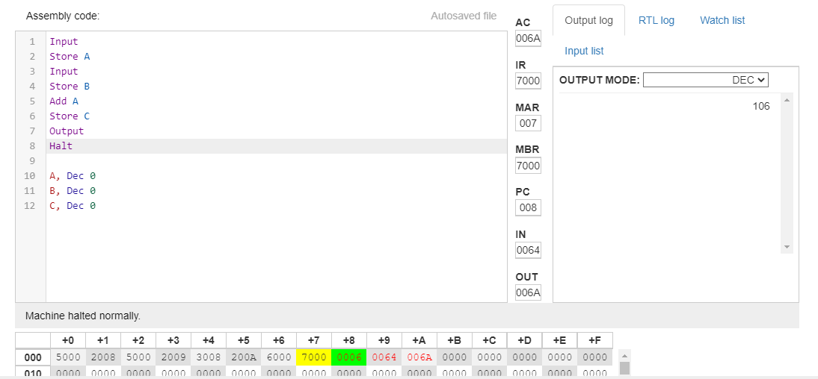
Activity 3: Marie Programming → Input, Output
Using MARIE.js, write a program to output the addition of two decimal numbers which are input by the user.

Slide 13
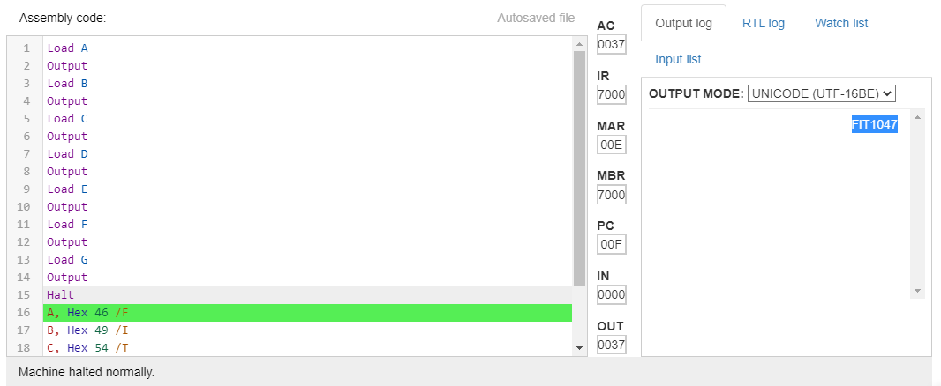
Activity 3: Marie Programming → Output
Using MARIE.js, write a program to output “FIT1047”

Slide 14
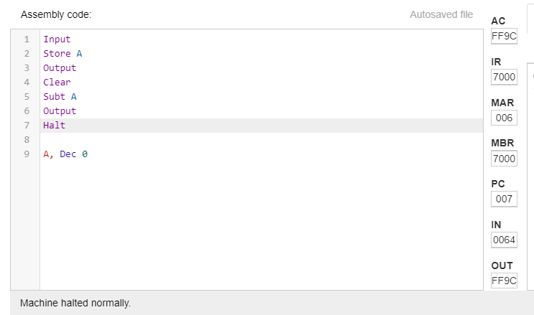
Activity 3: Marie Programming → Clear
Using MARIE.js, write a program to output the positive and negative forms of a input decimal value.

Slide 15
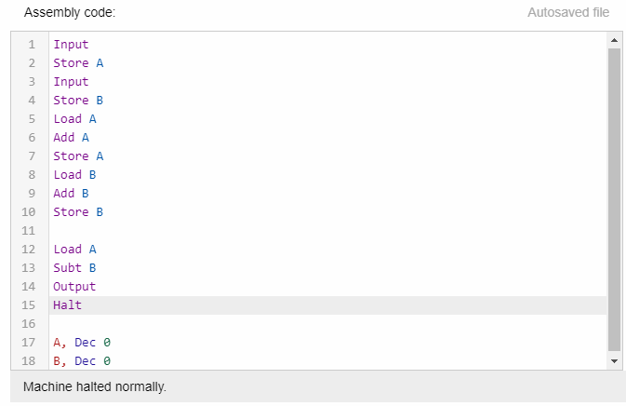
Activity 3: Marie Programming → Load, Store, Add, Subt, Halt, Input, Output
Using MARIE.js, write a program to allow the users to key in any X and Y values and print the output of Z = 2X - 2Y

Slide 16
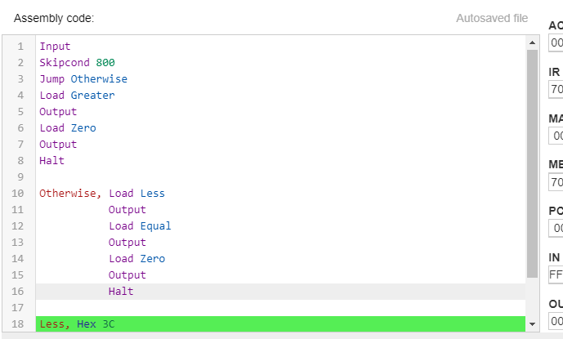
Activity 3: Marie Programming → Skipcond
Using MARIE.js, write a program to input a decimal value. If the value is greater than zero, print “>0”, otherwise, print “<=0”

Slide 17


